Slide 1
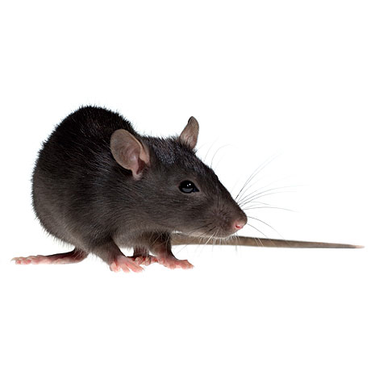
A
1 unit of
energy
4 units of
energy
C
Small-outcome state
Big-outcome state
Place preference
D
2 units of
energy
B
Internal state
Trial
Figure 2
Simulation specifications:
average over 2000 runs
algorithm: Q-learning + softmax
alpha = 0.25
beta = 10
gamma = 0.8
m = 2
n = 4
initial internal state = -50
optimal internal state = -3
big outcome = 4
small outcome = 1
energy expenditure per step = 2

